Slide 1
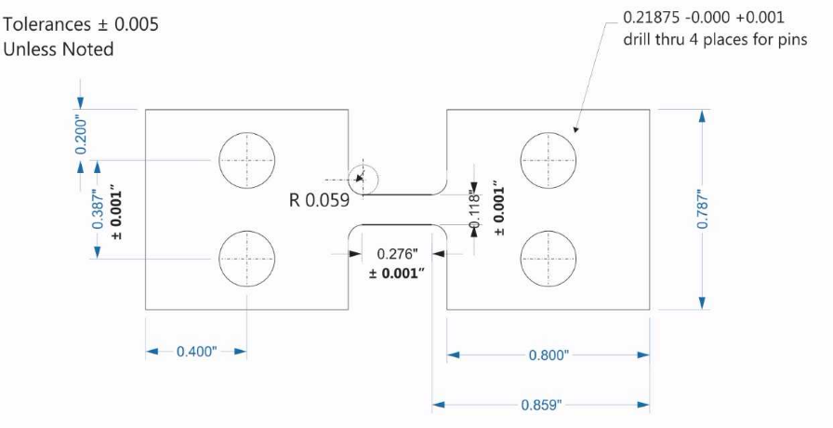
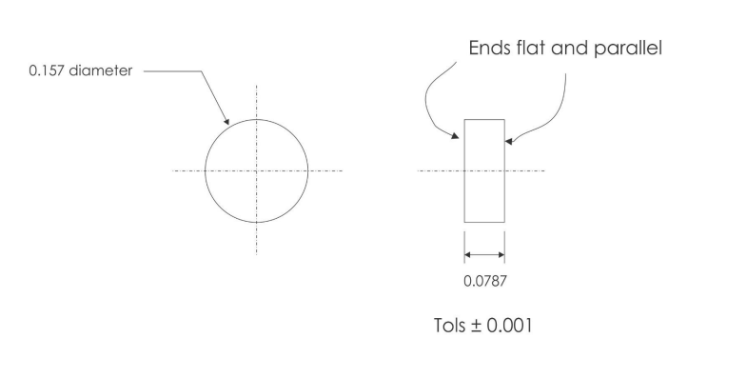
NIST SURF Program Final Presentation
Tension Specimen
Compression Specimen
A Study of Inconel 625 in both Tension and Compression at High Strain Rates using a Pulse-Heated Kolsky Bar
Author: Charlie Nitschelm
Mentor: Dr. Steven Mates
Notes:
Introduce myself, the project and Steve
Good afternoon! My name is Charlie Nitschelm and my talk will be on Inconel 625 in tension and compression under the mentorship of Dr. Steven Mates.

Slide 2
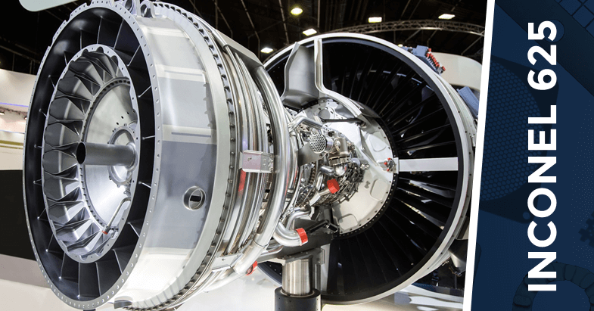
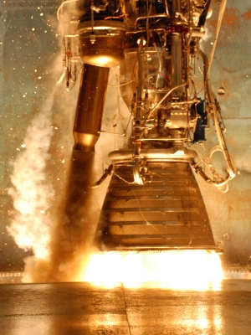
Why Inconel 625?
What it is: Inconel is known as a nickel-based superalloy. Small amounts of niobium combine with nickel form intermetallic compounds. These compounds form small cubic crystals that inhibit slip and creep effectively at elevated temperatures
Why is it useful?
High strength-to-weight ratio
The capabilities of the material as sheet metal
Oxidation and corrosion resistant
Great in high pressure and temperature environments
More resistant to creep than its competitors
Notes:
Inconel superalloy
Usefulness in industry
Why useful
Rocket engine
As you heard from the last talk, Inconel 625 is a super-alloy made of many different elements, but primarily nickel. Its usefulness in various industries, like aerospace and automotive, make it an extremely important material to understand. It is known to have a very high strength to weight ratio, it is oxidation and corrosion resistant and great in high pressure and temperature environments. This material is great in certain parts of rocket engines where it needs to not only survive its environment for one flight, but be able to be reused again and again like we see a lot of aerospace companies doing.

Slide 3
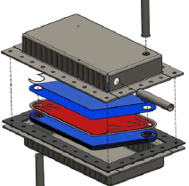
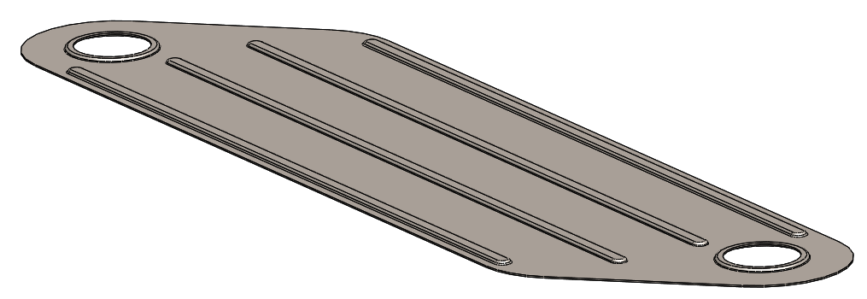
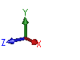
Heat Exchanger Background
*Designed by OSU
High Temperature Microchannel Recuperator:
25x10x13 cm
Lamina Insert
B. Paul, et al., Oregon State University, 2017
Notes:
Design a manufacturing process
Waste heat, industries, convert back to electricity
Waste heat generators operating conditions, why Inconel perfect
For our purposes, we are working to better design a process to manufacture a Lamina insert for a heat exchanger. There are huge amounts of waste heat everyday around the world, whether it be coal or oil, heat exchangers would enable our waste heat to be converted back into electricity . Waste heat generators operate at high temperatures and may encounter corrosive liquids, so Inconel 625 is a perfect choice of material for this challenging environment

Slide 4
Heat Exchanger Background
Lamina Insert:
0.5 mm thick
50 mm wide
178 mm long
+/- 5 % tolerance on height feature, i.e., +/- 0.025 mm
Traditional fabrication methods:
Photochemical Machining
Diffusion Brazing
Drawbacks:
Expensive
Over 50 % of material is wasted
Notes:
Walk down the slide
To design new process to cut down drawbacks and such
This lamina insert is very thin, around .5mm thick. Its traditional methods to manufacture now are time consuming, expensive and a lot of material is wasted. Our goal in this research is to design a new manufacturing process that will cut down on costs, limit material waste, and be able to achieve the same tolerances we get with the other methods.

Slide 5
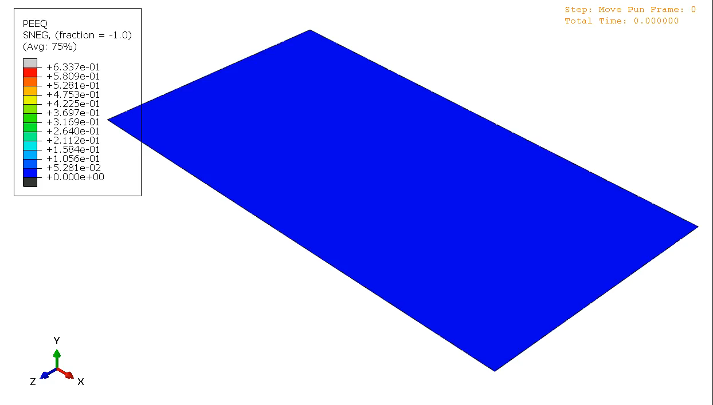

Dynamic Forming Process
Total Time: 1 second
Maximum Strain Rate:1000/s
Maximum Temperature: $900°∁$
Notes:
Effect of the deformation process – SR and T
Standard strain rate, 6 orders different
That is the reason to test at limits to be able to simulate the manufacturing process
In this Dynamic forming process, the material will be deformed very quickly, causing very high strain rates and large temperature increases due to adiabatic heating. These strain rates are close to 1000/s, where the standard, for example, of strain rate tests, are around 10 to the -3, around 6 orders of magnitude faster! That is the reason we will need to test this material at its limits of strain rate and heating times to understand how this material will behave under this process.

Slide 6
Physical Metallurgy of Inconel 625 (IN625)
Single phase Face Center Cubic (FCC)
No texture before rolling: the grains are equiaxed
Rolling introduces a lot of texture, changing the circle-like to oblong grains
Texture changes the orientations to favor a specific direction
Inconel 625 Wrought Microstructure
Mark Stoudt, NIST
Notes:
Walk down the slide
Can result in mechanical differences between the orinetation
Inconel 625 is a single phase, face center cubic metal, and you can see a typical microstructure to the right. This clearly shows that there is no texture to the material yet, meaning it has no specific orientation it favors. We say that the grains in this material are equiaxed (e qwe axed). But, once a material is rolled into sheet metal, the material we will be testing on and what the Lamina insert will be manufactured from, it begins to show a lot of texture, stretching grains into oblong (ahb long) grains and changing their orientations to favor a specific direction. This can result in a material that shows different strength depending on which direction you test it.
Forest dislocations are networks of dislocations, more dislocations the stronger it becomes, work hardening!
Increase strain, handle more stress which is due to these dislocations
Electron back scatter diffraction (EBSD) taken in SEM, colors show the orientation of the grains within the metal.
Rolling introduced texture to the metal, which creates grains with preferred orientations which is why we need to test
Various directions to rolling. The picture was not the actual sheet metal we tested, but the metallurgy of a random metal.

Slide 7
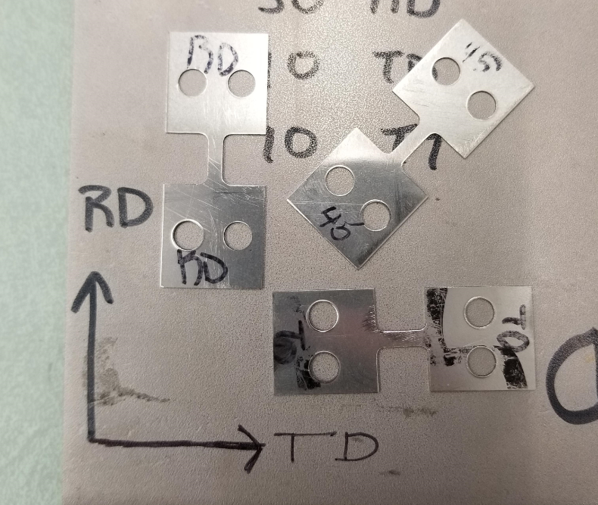
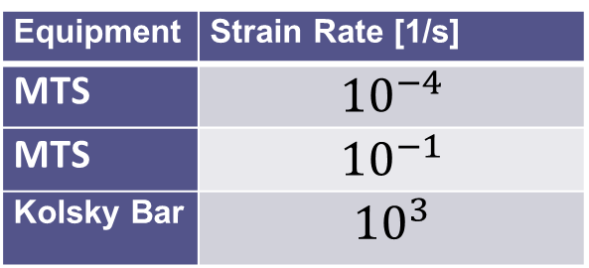
Testing Conditions
Equipment | Strain Rate [1/s]
MTS | $${10}^{−4}$$
MTS | $${10}^{−1}$$
Kolsky Bar | $${10}^{3}$$
5cm
The Servo-Hydraulic Test Machine (MTS) can achieve low strain rates.
The Kolsky Bar can achieve high strain rates
The texture of the .5mm IN 625 sheet metal needs to be tested at different orientation to understand the effects of the new metallurgy
Notes:
Bottom text
How material behaves at low and high strain rates
Right text
Which has to use specifically designed tension specimens
That is why we will be testing Inconel 625 in various direction to fully understand how the material behaves under the influence of its new texture. From the new dynamic forming process, we will also have to understand how the material behaves at low and high strain rates. To test these conditions, we are using a servo hydraulic test machine so we can achieve the low strain rates of 10 to the -4 and 10 to the -1/s. To achieve the strain rates closer to 1000/s, we will be using a Kolsky bar.
MTS is actually the trade name of the machine. I know MTS is probably in all your plots, so lets keep it, but ordinarily we would just say “servo-hydraulic” load frame. Also, FYI, the load frame applies force by the use of high pressure fluid (hence it is called a hydraulic load frame). There are other kinds of testers that use a screw (screw-driven machines) and others that use an electromagnetic coil (for low loads), FYI

Slide 8
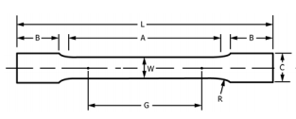
NIST IN625 Tension Specimen vs ASTM E8 Standard
NIST Tension Specimen
ASTM Standard Tension Specimen
1. Specimen uses the full thickness of sheet for a .5 mm thickness
1. Requires the specimen to use the entire thickness of the sheet metal
2. The gage length is designed to 7 mm because of the limitations of the applied force and displacement of the Kolsky Bar
2. Requires a minimum gage length (G) of 32 mm for each specimen
3. The Gage length to gage width ratio is 4:3
3. Gage length to gage width ratio of at least 4:1
4. Ensures a strain of ~.35 for each test, assisting with the likelihood of capturing fracture
4. If all suggestions are applied to the NIST Tension Specimen for the Kolsky Bar, a strain of .11 would be achieved.
Notes:
Kolsky bar great, but has limitations and currently has no standard for testing specimens, ASTM American Society for Testing and Materials, Americas primary mechanical testing standards organization
ASTM E8 for slow, go through points
Kolsky 3mm limitation
Need to get strain near fracture for usefulness in data, what we get in dynamic forming
The kolsky bar is a great tool to understand how large strain rates affect the mechanical behavior of a material, but it also has its limitations that need to be accounted for. There is a standard test method for testing metals in tension, and in that standard it specifies how the test specimen must be designed. Although we follow a few guidelines, like using the entire thickness of our .5mm sheet of Inconel 625, we fall once we get to the recommended gage length. The ASTM E8 standard requires a 32mm gage length, while we were forced to design it to only 7mm. This is because the Kolsky bar can only stretch the sample a certain length during the time of the test, and we need to achieve a strain that would get us close to fracture. From that, we do not follow the guidelines of E8, but it does allow the test to occur so we can discover useful data on its behavior at these high strains.
E8 is not only specimen but also testing rates, (usually slow)

Slide 9
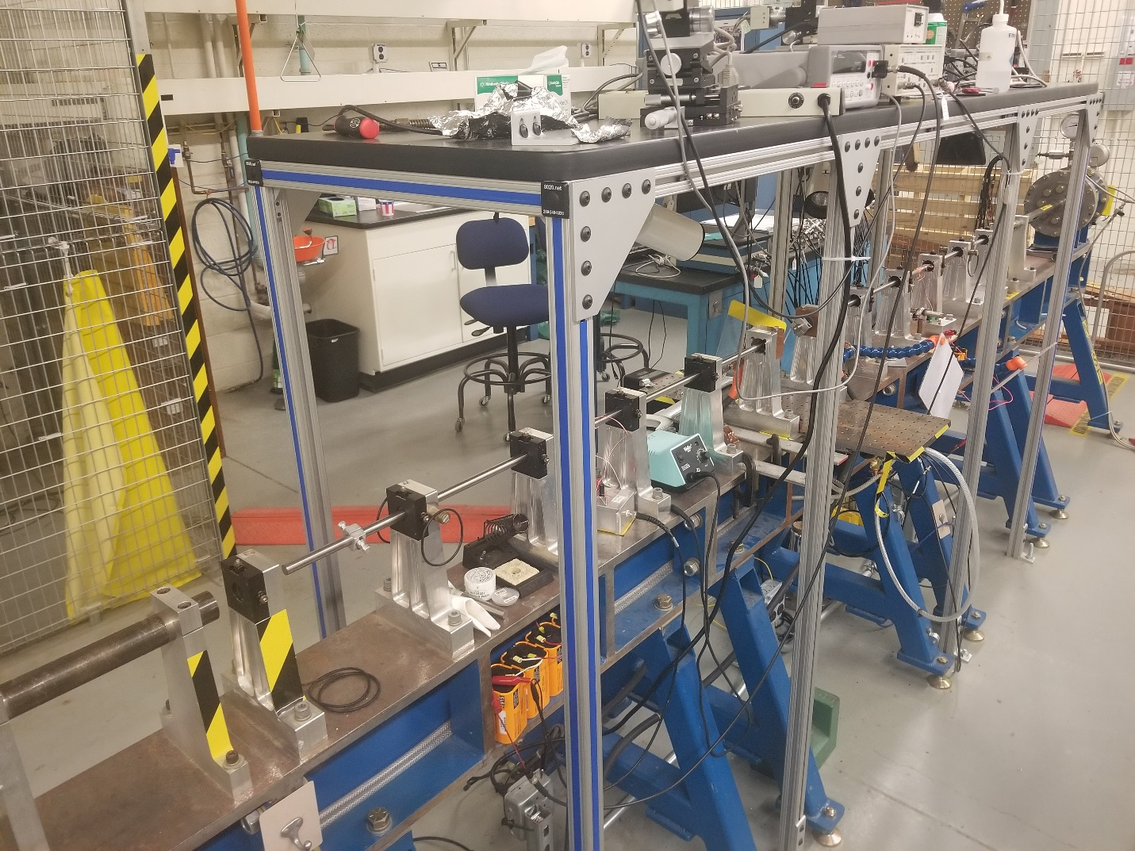
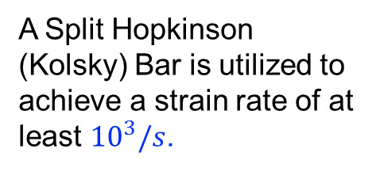
Testing Conditions – High Strain Rate
A Split Hopkinson (Kolsky) Bar is utilized to achieve a strain rate of at least ${10}^{3}/s$.
This strain rate is crucial to understand for its applications in aerospace and high speed machining. These areas exhibit the types of conditions seen from a Kolsky Bar test.
Notes:
Walk down text, comment on cleanliness?
Pictured to the right is the Kolsky bar, designed for strain rate around 1000/s, which is crucial to understand for the applications that see these strain rates, like dynamic forming, high speed machining, and automobile crashes.

Slide 10
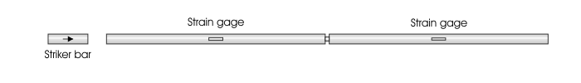
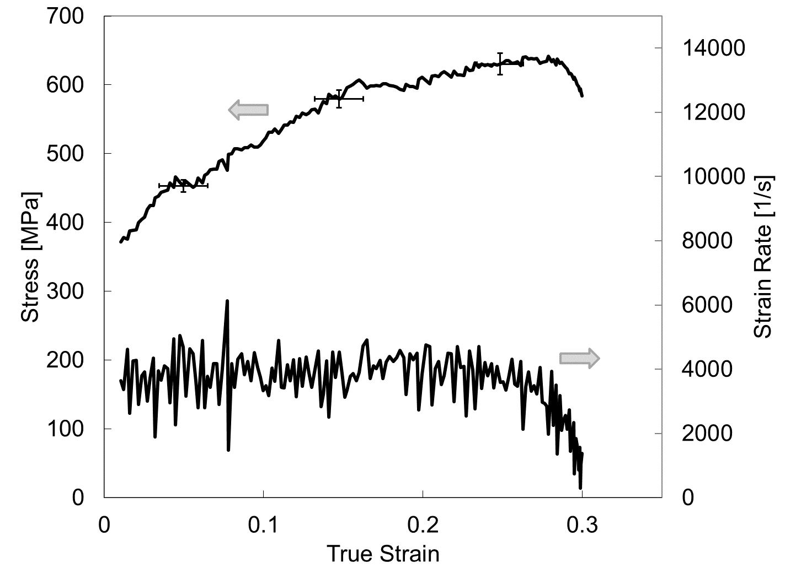
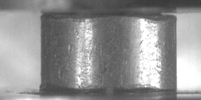
Kolsky Bar: Basic Mechanics
Test Sample
Pulses Travel at the Speed of Sound in Steel (~ 5000 m/s)
But, the deformation velocity is only about half the striker velocity
(~ 8 m/s here)
Stress-Strain
Strain Rate
2 mm thick sample
at 30,000 frames per second
Notes:
Walk down the animation
Speed of sounds and compression and tension difference
The Kolsky bar functions by introducing a striker bar that hits the incident bar, pushing a compression wave towards the sample, and producing a reflected and transmitted pulse. These pulses are then collected by the strain gages on each bar which is then able to graph a stress strain curve of the experiment at the strain rate experienced. These pulses move at the speed of sound in steel, roughly 5000m/s. Although this example was for compression, which we will see in a few minutes, tension is can also be accomplished by inverting the striker bar impact direction.
Whole tests lasts about 0.1 milliseconds
Simple compression. Also have the ability to work in tension.
Tension as well, pulls instead of pushes on

Slide 11
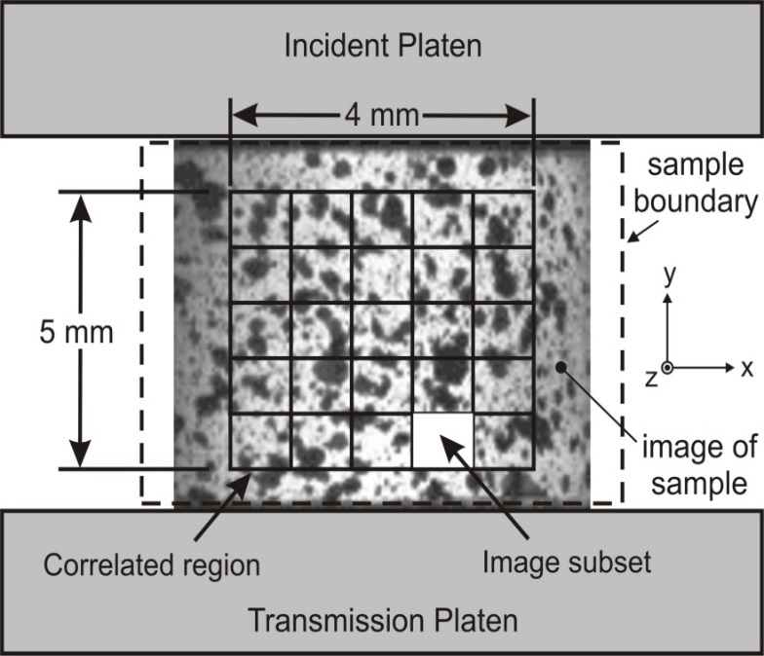
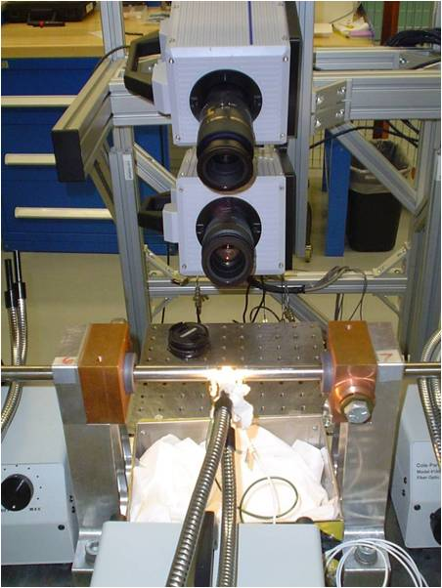
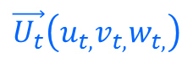
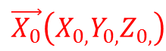
3D Digital Image Correlation (DIC)
Overlapping Image “Subsets”
3D Displacement
$$\vec{U_{t}}\left(u_{t,}v_{t,}w_{t,}\right)$$
20 pixels
Cameras
20 pixels
(Image from one of the cameras)
Sample
Image Pair “Subset”
$$\vec{X_{0}}\left(X_{0,}Y_{0,}Z_{0,}\right)$$
3D Initial Position
Allows us to measure SHAPE, DISPLACEMENT and STRAIN locally on our tension samples
Notes:
Another more modern, 3d DIC
Two HS camera
Look at gage section
Speckle
Track, shape displacement and strain locally
Another, more modern, way of collecting our data during the tension tests is using 3d Digital image correlation. This setup requires two high speed cameras looking at the specimen during the test. The specimen is painted at the gage section with a white background and black speckles. The cameras are then able to track these speckles as the gage deforms, producing the shape displacement and strain locally for each frame captured during the test.
Measures strain not stress duh

Slide 12

Kolsky Bar Tension Test
Notes:
Here is a movie from one of our tensile tests, showing the movement of the specimen as the tensile waves passes through. You can also clearly see the speckled paint on the specimen, so the cameras can produce a graph detailing its deformation through time.
When paint delaminates, DIC is useless and stops
Bad correlation

Slide 13
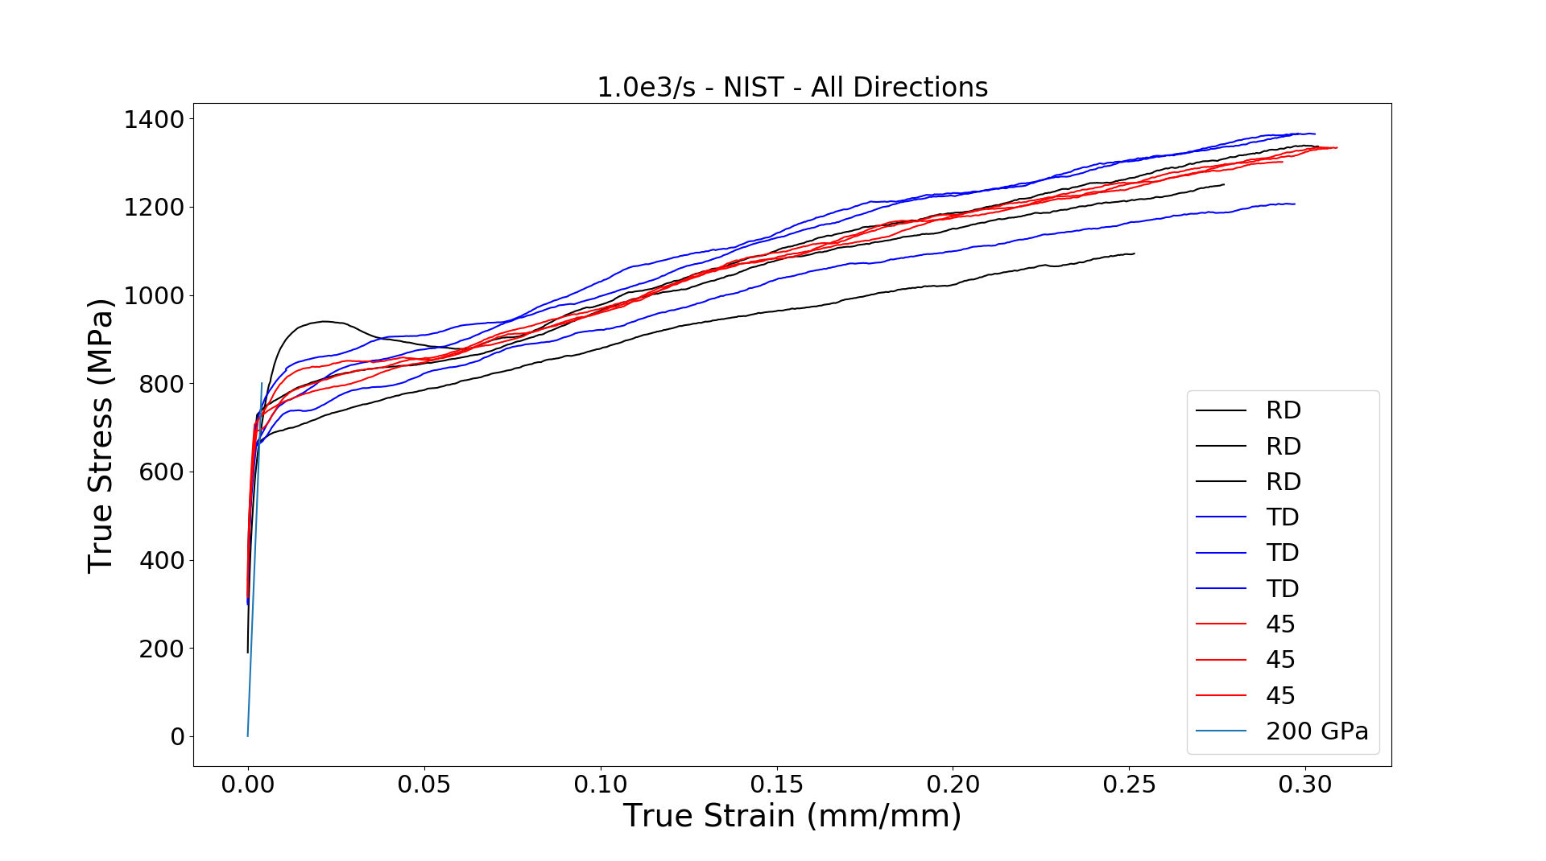
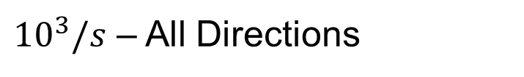
High Strain Rate Test Results
${10}^{3}/s$ – All Directions
Notes:
Intro to the graph
200 Gpa
Scatter, error in rolling direction
Trend?
This graph details the results from the high strain tests at the various orientations. At the bottom of the legend, there is a line simulating the elastic strain of the test, which Inconel has an elastic modulus of 200 GPa. It is difficult to get accurate elastic strains in these tests, so it is preferred to assume the elastic strain we would see, and match the end of elastic strain with the beginning of the plastic strain recorded, also known as the yield strength. There is definitely some scatter, including an error in one of our rolling direction experiments, but you can begin to see a trend in how the material behaves.
If question about shifting, kinda what we did, but a lot more goes into it to achieve an accurate results
Holloman, and hooks law to match up the beginning of the plastic to end of elastic.
Stress = A*strain^n power law
Stress = modulus * strain
Find intersection, find correct yield stress and there is an error in the yield strain because of slippage, misalignment, experimental factors etc, so we correct yield strain with the yield stress and the correct modulus.

Slide 14
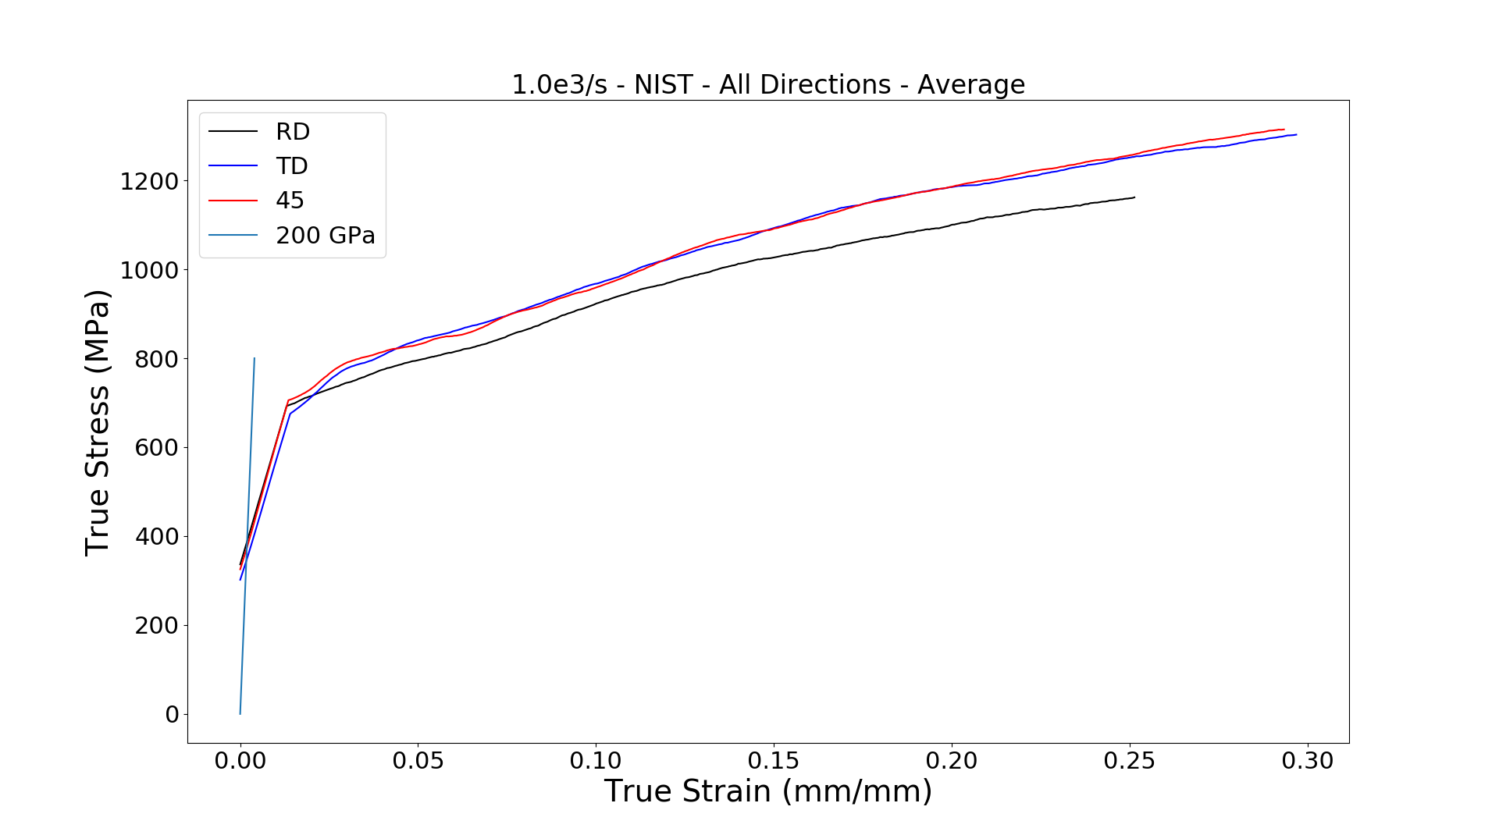
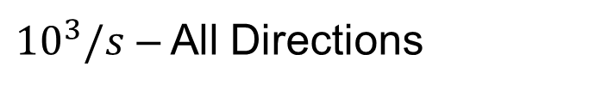
High Strain Rate Test Results - Average
${10}^{3}/s$ – All Directions
Statistically insignificant?
Notes:
If I bring average values…. RD?
Add error bars, maybe it is statistically insignificant
If I bring up the average values of each direction, you see that the rolling direction, the orientation that moves with the microstructure, shows less strength throughout the stress strain curve. But also note the error bar, which is a calculation of error propagation estimated from the test that could lead to the orientation not being significant in mechanical strength.

Slide 15
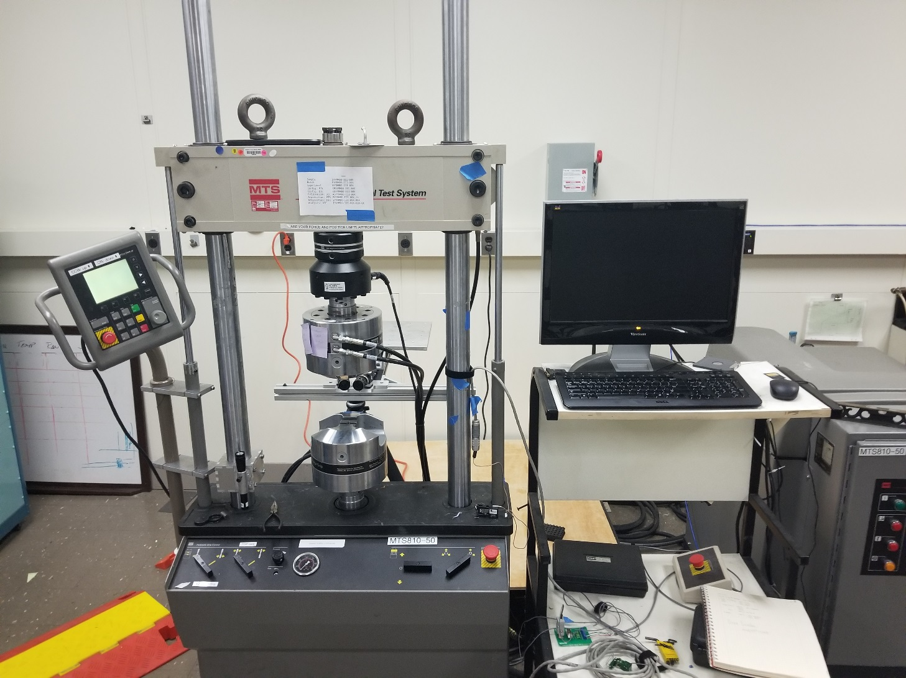
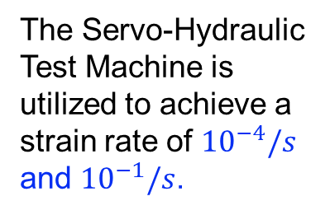
Low Strain Rates
The Servo-Hydraulic Test Machine is utilized to achieve a strain rate of ${10}^{−4}/s$ and ${10}^{−1}/s$.
This strain rate is important to understand for its mechanical properties when it is subject to a increasing load over a longer period of time.
Notes:
Reference picture, low strains
Reference text
Lamina manufacturing experiencing many strain rates simultaneously
Pictured to the right is the servo hydraulic testing machine that was used for our slower strain rates. It is also important to understand how Inconel 625 behaves under an increasing load over a longer period of time . Because the lamina being deformed via the dynamic forming operation is experiencing many strain rates simultaneously (including the maximum one) we need to understand how this material behaves over a wide range of strain rates

Slide 16
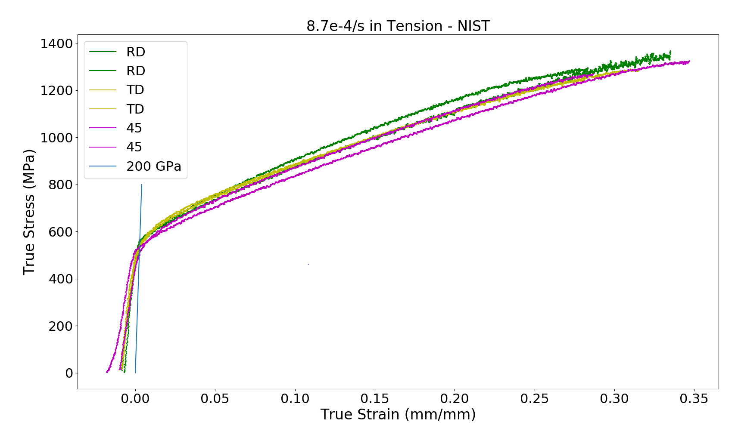
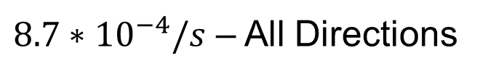
MTS Test Results - Slow
$8.7∗{10}^{−4}/s$ – All Directions
Notes:
How long data collected
Identical behavior?
Texture and orientation don’t play a role
Rolling?
These data here were gathered over a time interval of around 2 hours due to such a low strain rate of 8.7 * 10^-4/s. With these curves, it shows that each orientation behaves almost identically with each other, meaning the texture and orientation at these low strain rates do not play a crucial role in its mechanical behavior in tension, but rolling direction is slightly favored.

Slide 17
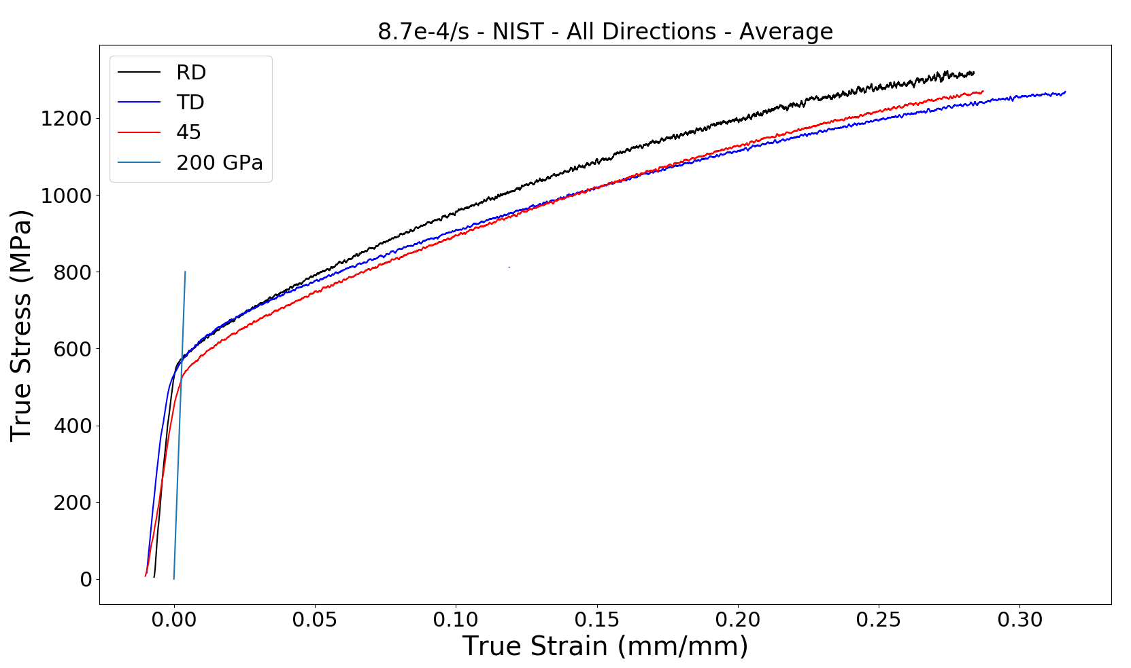
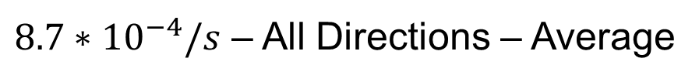
MTS Test Results – Slow - Average
$8.7∗{10}^{−4}/s$ – All Directions – Average
Notes:
With averages, RD?
Error bars – statistically insignificant
Cant conclude RD can withstand higher stress
You can see this more clearly when the averages are displayed for each specific orientation. The error bars also show that the error propagation is significant enough to not conclude that rolling direction behaves far differently then the other directions.

Slide 18
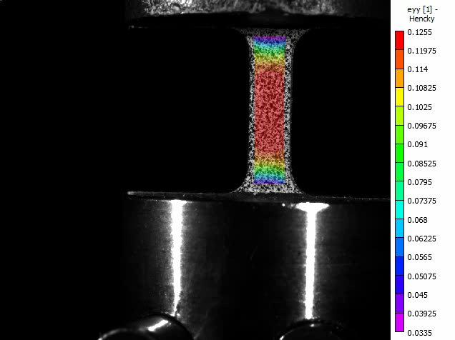
MTS Tension Test
Max Strain: 0.44
True Strain Magnitude
Notes:
Explain video! Reference the speckles
Here is a video of what the DIC records during the test. As the test progress’, the strain near fracture increases until fracture occurs. The speckles painting on the specimen allows these cameras to make the measurements.

Slide 19
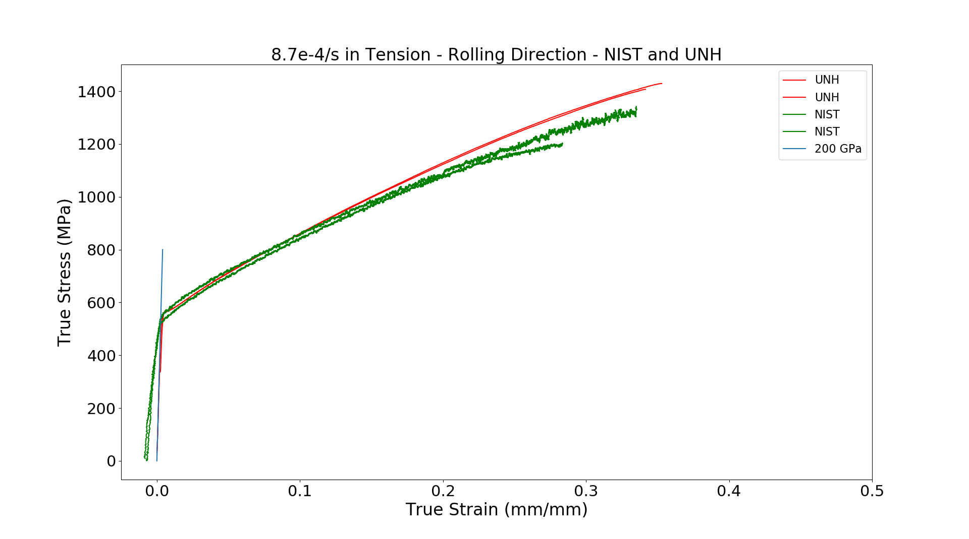

E8 vs. High Rate Specimen
$8.7∗{10}^{−4}/s$ – Rolling Direction
Notes:
Importance of difference in specimen for data
Explain graph, E8 for MTS but we used for kolsky and MTS
Disagreement? With error bar
One point that is extremely important to verify is if our tension specimen yields vastly different results due to its different design compared to the E8 standard specimen. This graph illustrates this exactly. The red lines is the data collected at the University of new Hampshire using an ASTM E8 specimen on an MTS, where the green shows our tension specimen data on the MTS. Although there is a slight disagreement at the later strains, these data are very similar, especially taking into account the error bar shown.
Forced to use non standard specimen, and we wanted to see that this choice caused any significant problems to measuring the mechanical behavior in tension from the standard E8
Did you assume .5mm for every sample or did you measure each one?

Slide 20
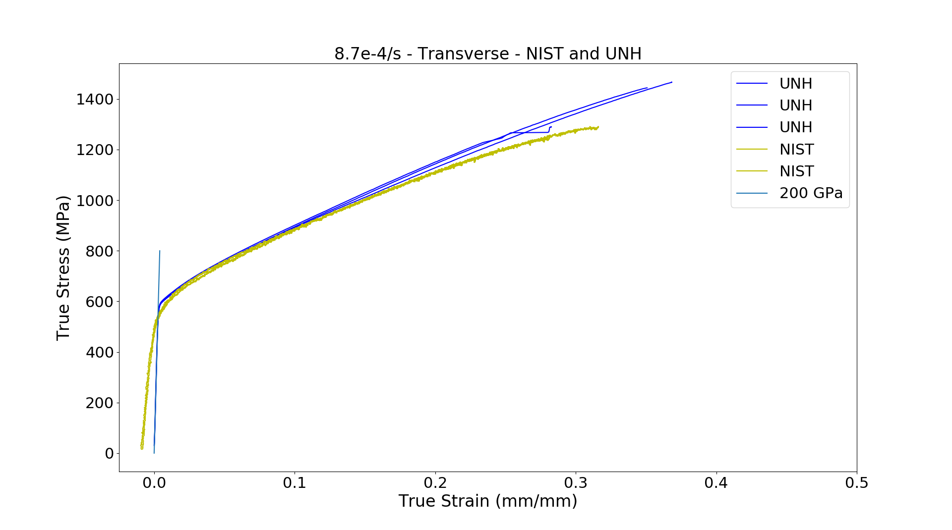
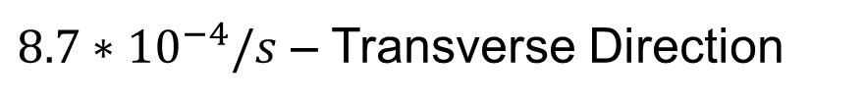
E8 vs. High Rate Specimen
$8.7∗{10}^{−4}/s$ – Transverse Direction
Notes:
We see these same results in each orientation, like here in the transverse direction.

Slide 21
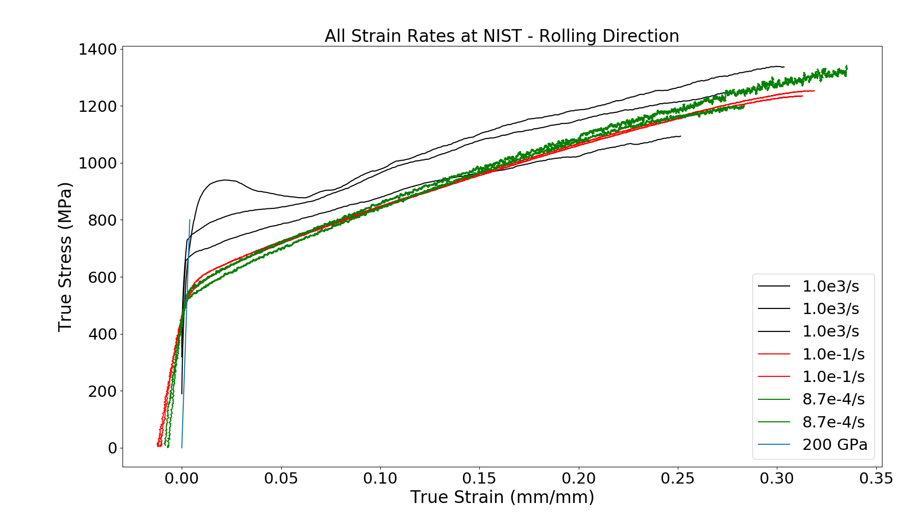
Strain Rate Sensitivity
All Strain Rates – Rolling Direction
All Strain Rates – Rolling Direction
1000/s
1000/s
1000/s
0.1/s
0.1/s
.00087/s
.00087/s
Notes:
Strain rate sensitivity importance
Outlier in RD
Trends?
By testing multiple strain rates, we are able to see how strain rate effects a certain orientations mechanical behavior clearly. Apart from the high strain rate outlier here, you can begin to see trends…
Positive, higher strain rate, higher YS and yield

Slide 22
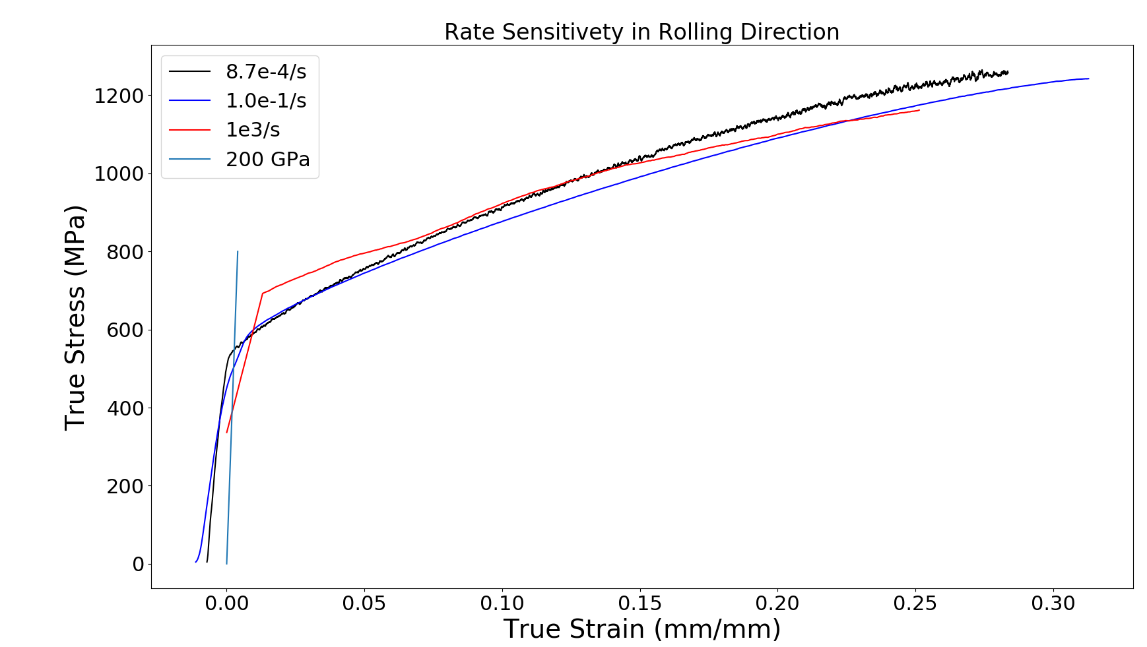
Strain Rate Sensitivity
All Strain Rates – Rolling Direction
.00087/s
0.1/s
1000/s
Notes:
These averages clearly show how each strain rate can affect the mechanical behavior of the material including how much strain it can take before fracture.
Peculiar because usually higher strain rate, stronger, but here the slower strain rate is stronger

Slide 23
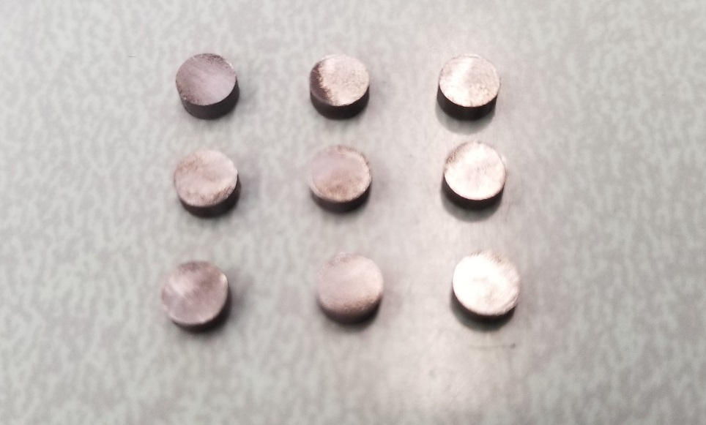
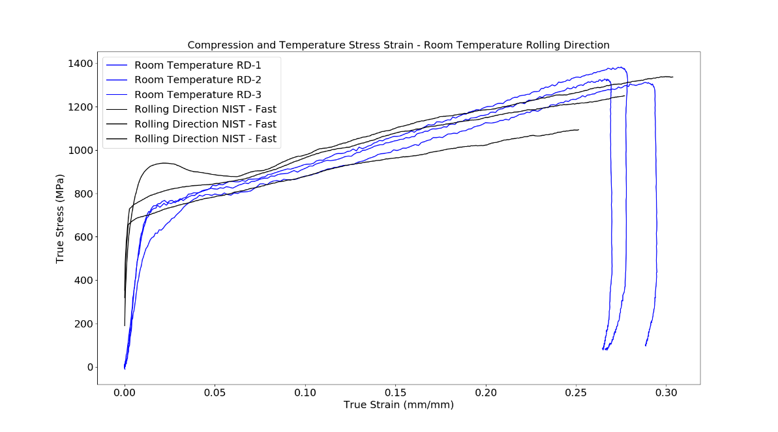
IN 625 Compression Specimens
The IN 625 compression tests will be used to probe its deformation mechanics
These data will derive the parameter of thermal softening in the Johnson-Cook equation,
Allows us to better design the lamina part
4mm
These specimens are manufactured using an EDM taken from the material of an Inconel 625 plate.
The characteristics were very similar to the Inconel 625 sheet used for tension
Notes:
Dynamic forming – temperature change
Why compression over tension
Wont impact data?Plate vs sheet,verified similar properties so can translate the thermal softening behavior of plate to the sheet metal we are interestedin
Trust it.
Another important effect the material will undergo during dynamic forming is temperature change. We chose to use compression specimens for our heating data because it is far easier to heat compression specimens then tension specimens, and the graph on the bottom right shows that choosing the compression specimens for temperature testing did not significantly affect its stress strain curve, allowing us to trust the data we get from the tests.
Compression tests at high rate and T because we want to find the thermal softening rate of IN 625. Dynamic forming has high speeds and short times, adiabatic heating, heats up from plastic work, and its important to know how the strength of IN 625 varies with Temp
Doing this in compression because it is simpler experimentally to get the results
Graphics bigger
Not the .5mm sheet, used thicker plate. Differences in rolling? Nope, looks very similar

Slide 24
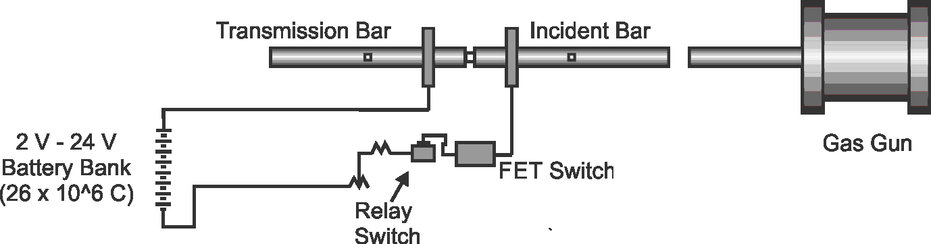

Pulse-Heated Compression Kolsky Bar
Samples are heated electrically in a few seconds prior to high strain rate compression test
30,000 fps movie, heating to 800 °C in 1 sec with 2 second hold prior to impact
Mates, SP; et al., EXPERIMENTAL MECHANICS, 48 [6], 799-807, 2008
Notes:
Explain bar, prior to mechanical deformation!
As a kolsky bar outfitted with pulse heating, the mechanics is nearly the same, except prior to mechanical impact, a battery banks supplies a large amperage to the specimen, allowing it to be heated to nearly 1000 C in just a couple of seconds. The current is then cutoff and is immediately followed with mechanical deformation.

Slide 25
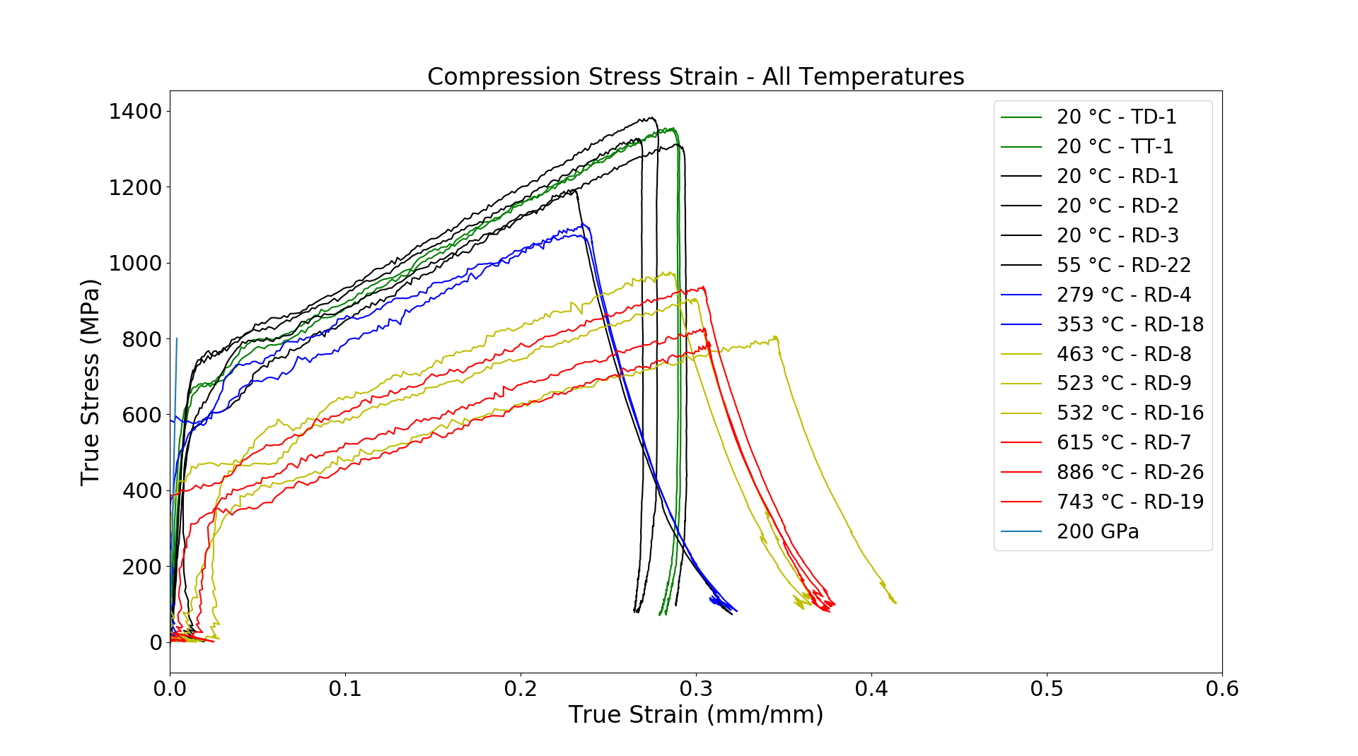
Compression Test Results – All Temperatures
Compression Thermal Softening
Notes:
Shows thermal softening, the true stress it can withstand drops as T increases, (do line)
All data allow us to calibrate a model to simulate
This busy graph show how the mechanical strength drops as temperature increases, a well-known trend in materials science. All the data we gathered, including strain rate and temperature effects, will allow us to calibrate a model for Inconel 625 that is suitable to simulate the dynamic forming process shown earlier.

Slide 26
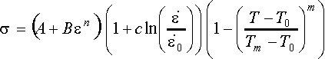
Johnson-Cook Model
Constitutive Model
Johnson-Cook plasticity
Accounts for temperature, strain rate and plastic hardening
Simplest model (fewest coefficients - 5) that captures these combined effects
Combines with Linear Elasticity in Finite Element Model
Notes:
Well known
Captures strain and t sens and works on many metals
The parameters found
Help correctly design the lamina part of heat transformer
The Johnson-Cook model is a well-known equation that captures strain rate and temperature sensitivity of mechanical strength, and it works well for many metals. The parameter values needed for Johnson-Cook model, which will allow us to correctly design the dynamic forming process, are thermal softening, rate sensitivity and yield and hardening parameters.

Slide 27
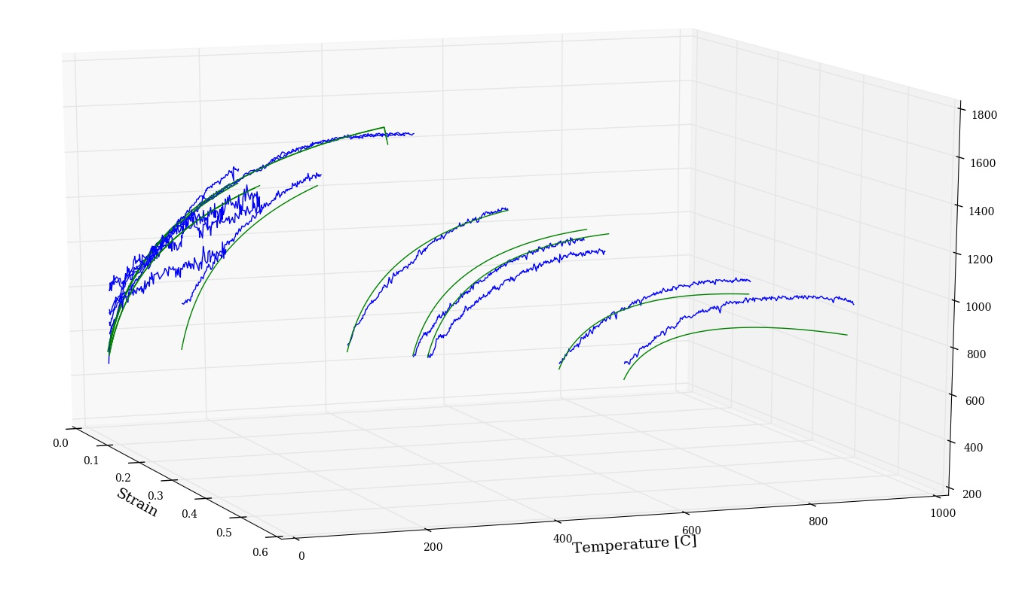
Johnson-Cook Fit
1800
1600
1400
1200
1000
800
600
400
200
True Stress (MPa)
0 200 400 600 800 1000
Temperature [C]
11 experiments
Various strain rates
Various temperatures
Notes:
So far in the research, we have been able to fit 11 of our experiments to the johnson cook model. These experiments include the various strain rates, which were all done in room temperature, and the compression tests which are these curves…
Although there is more work to do on the accuracy, like adding more of our data, we can see that in some experiments, the fit is a good representation of the experimental data, but in other experiments we see the fit steering away from the actual data. This model is simple, and tends to not be able to fit wide ranges of conditions, like strain rate and temperature.
Why use it: it shows good broad agreement to the data and is widely applicable to the other metals
And it is also easy to calibrate it compared to other models. When you want to see those large regions of
Conditions, you need much more data. Simplicity is a great feature.
This simple model only has 5 paramater

Slide 28
Conclusions
Measured the mechanical behavior of Inconel 625 sheet metal at various strain rates and orientations to determine the rate sensitivity and strain hardening behavior.
Measured the compression behavior of Inconel 625 plates at high strain rates with rapid heating before deformation to determine the thermal softening.
Obtained reliable data to understand to fit Johnson-Cook model to simulate the dynamic forming of the lamina component in a heat exchanger.
Huge thanks to Dr. Steven Mates for all his help over the program.
Notes:
Overall, during this Summer we were able to measure the mechanical behavior of Inconel 625 at various strain rates and orientation to its rolling texture and test the thermal softening of the material in compression. These data will then be able to be fit to the Johnson-Cook flow stress model that can then accurately simulate the dynamic forming of the lamina component ins a heat exchanger. Thank you.
Scatter plot, repeat measurement, shows scatter with stress strain, tough to handle thickness of very small specimens. Plot new one with average value, less scatter

